Slide 1
Sage ERP X3 User Parameters

Slide 2
User Parameters Setup > Users > Users
Parameter Definition tab
Applies to v5/v6/v7 – shown in v7
Allows you to define some parameters specific to the user.
User parameters can override the values set at the folder or company level for that user.
Not all parameters are available at the user level.

Slide 3
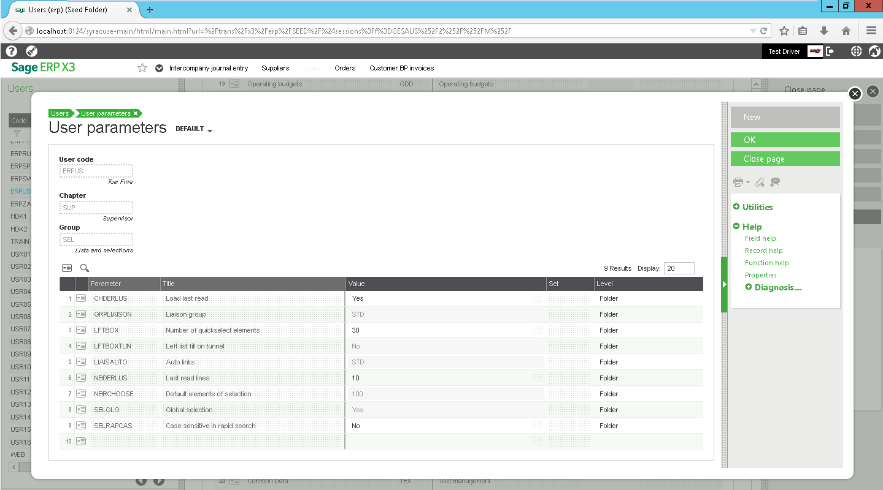
User Parameters SUP > SEL

Slide 4
Supervisor Lists and Selection Parameters
CHDERLUS – Load last read
Generally yes when you open to review records, but if a user spends most of the time creating new ones, they may prefer no.
YES = when you open a function you will see your last read record
NO = when you open the function, you’re on a blank screen

Slide 5
Supervisor Lists and Selection Parameters
LFTBOX – Number of quickselect elements
Numberic value – the larger the number, the longer your screen may take to open.
Enter the number of records that should be displayed in the left list box when a user is viewing a function window

Slide 6
Supervisor Lists and Selection Parameters
LFTBOXTUN – Left list fill on tunnel
This impacts how fast a screen loads. No list opens faster!
NOT a user parameter (that’s why it is grayed out)
Yes = The left list will fill in when you tunnel from another function
No = The left list will remain blank until you refresh the function window

Slide 7
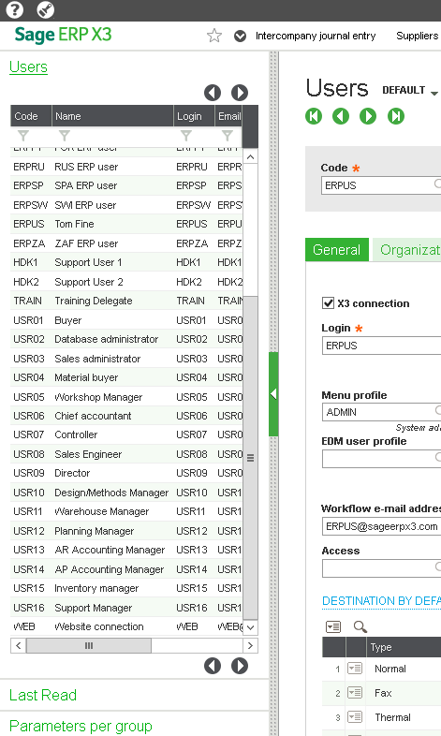
Supervisor Lists and Selection Parameters
NBDERLUS – Last read lines
Numeric value
The number of lines to fill in on the left list “last read” drawer

Slide 8
Supervisor Lists and Selection Parameters
SELRAPCAS – Case sensitive in rapid search
Defines if the left list search by column is case sensitive.
Yes = Walmart is different than WalMart so only one will display
No = Walmart and WalMart are both displayed

Slide 9
Supervisor Lists and Selection Parameters
NBRCHOOSE – Default elements of selection
NOT a user parameter, defined at the Folder
Defines how many lines are read and displayed in a selection window (select, F12) – the fewer, the faster it opens…but might take more time for the user to search.
Numeric value

Slide 10
Supervisor Lists and Selection Parameters
SELGLO – Global Selection
Determines if memos for selection are shared or only personal.
YES = everyone can see and use the memos
NO = memos created for only that user, but they can still use other people’s global memos

